Slide 1
COSC 2430
Review – part1

Slide 2
(a) What is the difference between shallow and deep equality tests on Arrays in Java?
int arr1 [] = {10, 20};
int arr2 [] = arr.clone();
System.out.println(arr.equals(arr2));
System.out.println(arr1==arr2);
Shallow compare:
System.out.println(Arrays.equals(arr1, arr2));
False
False
arr1 and arr2 are two references to two different objects. So when we compare arr1 and arr2, two reference variables are compared
True

Slide 3
(a) What is the difference between shallow and deep equality tests on Arrays in Java?
int arr1 [] = {10, 20};
int arr2 [] = {10, 20};
Shallow compare:
System.out.println(Arrays.equals(arr1, arr2)); -> True
Arrays.equals() works fine and compares arrays contents.
What if the arrays contain arrays inside them or some other references which refer to different object but have same values.

Slide 4
(a) What is the difference between shallow and deep equality tests on Arrays in Java?
import java.util.Arrays;
class Test
{
public static void main (String[] args)
{
// inarr1 and inarr2 have same values
int inarr1[] = {1, 2, 3};
int inarr2[] = {1, 2, 3};
Object[] arr1 = {inarr1}; // arr1 contains only one element
Object[] arr2 = {inarr2}; // arr2 also contains only one element
if (Arrays.equals(arr1, arr2))
System.out.println("Same");
else
System.out.println("Not same");
}
}
import java.util.Arrays;
class Test
{
public static void main (String[] args)
{
// inarr1 and inarr2 have same values
int inarr1[] = {1, 2, 3};
int inarr2[] = {1, 2, 3};
Object[] arr1 = {inarr1}; // arr1 contains only one element
Object[] arr2 = {inarr2}; // arr2 also contains only one element
if (Arrays.deepEquals(arr1, arr2))
System.out.println("Same");
else
System.out.println("Not same");
}
}
Not Same
So Arrays.equals() is not able to do deep comparison.
Same
So Arrays.deepEquals() is able to do deep comparison.

Slide 5
(b) How would you backup (copy) all elements of an array to a new array using a *single* Java statement?
String [] arr = new String[3];
for (int i=0; i<3; i++)
arr[i] ="hello";
String [] arr2 = arr.clone();
for (int i=0; i<3; i++)
System.out.println(arr2[i]);
hello
hello
hello

Slide 6
(C) Provide an algorithm/pseudocode for finding the penultimate (second-last) node in a doubly linked list where the last node is indicated by a null next reference.
Node<E> first = head;
if (first==null || first.next==null)
return null;
Node<E> second = fisrt.next;
while (second.next !=null) {
first = second;
second = second.next; }
return first;

Slide 7
(d) Provide an algorithm/pseudocode to find the 𝑘th last element of a singly linked list starting with only the header sentinel?
Node<E> fast = head;
i=1;
while(fast != null && i<k) {
fast=fast.next;
i+=1; }
if (fast==null)
return null;
Node<E> slow = head;
while (fast.next!=null)
{ slow = slow.next;
fast = fast.next; }
return slow;

Slide 8
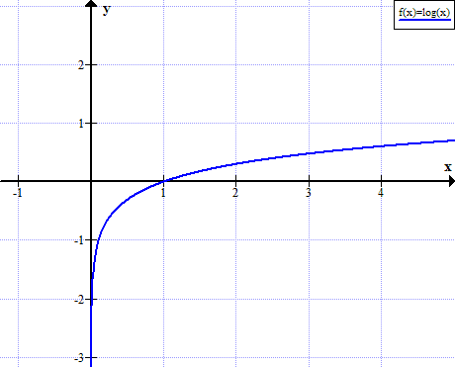
(e) Which function has the similar profile (i.e., the same “shape”) in the log-log scale as it is in the classical y/x scale? Y=log(x), an Increasing function

Slide 9
(f) How does one order these functions based on non-increasing asymptotic growth rates?

Slide 10
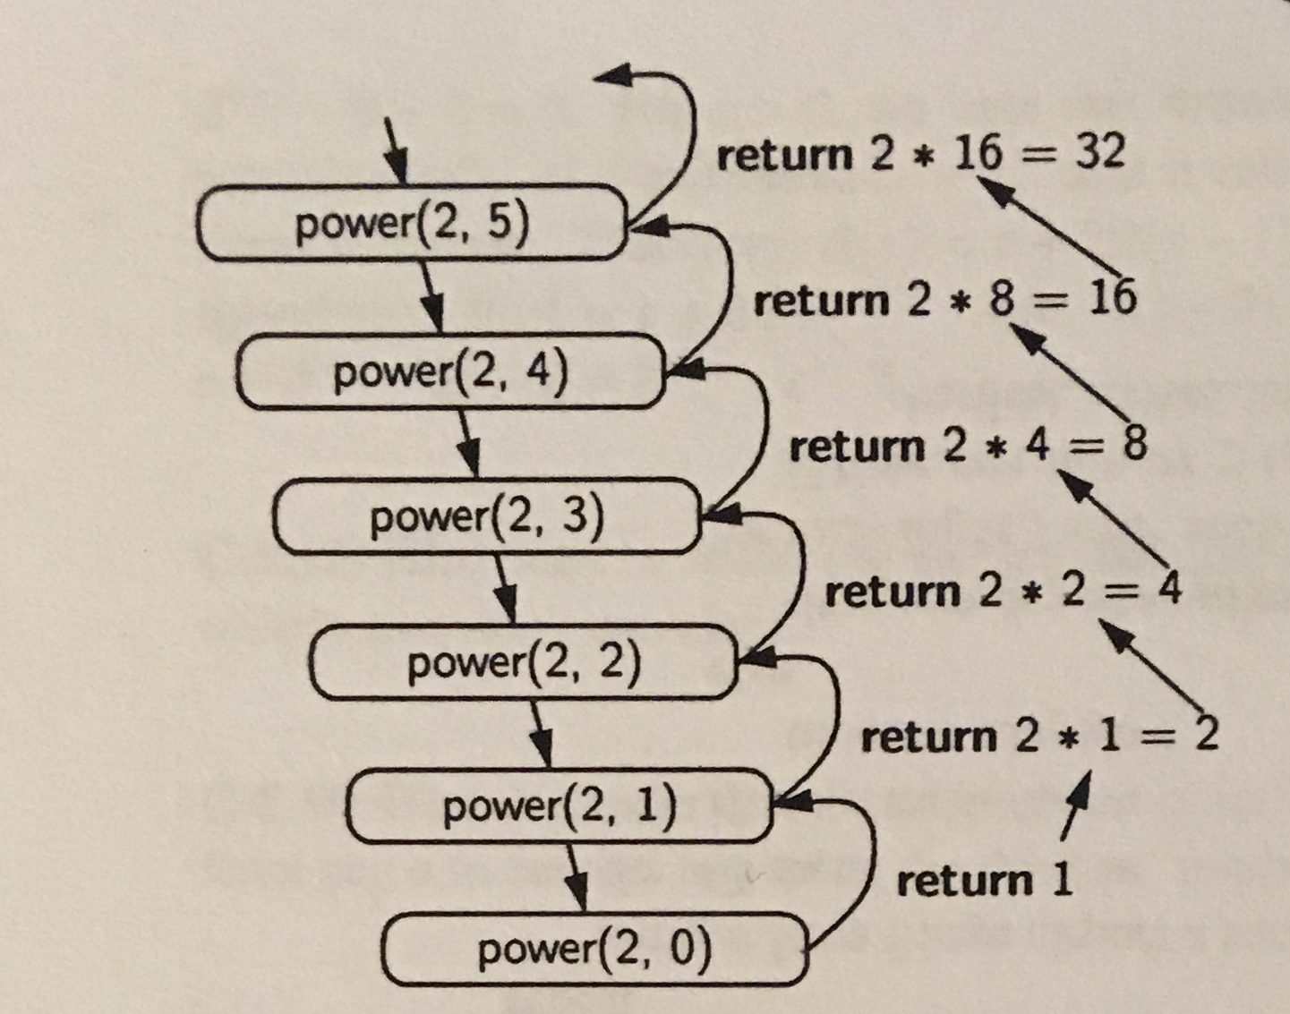
R-5.3 Draw the recursion trace for the computation of power(2,5), using the traditional algorithm implemented in Code Fragment 5.8.

Slide 11
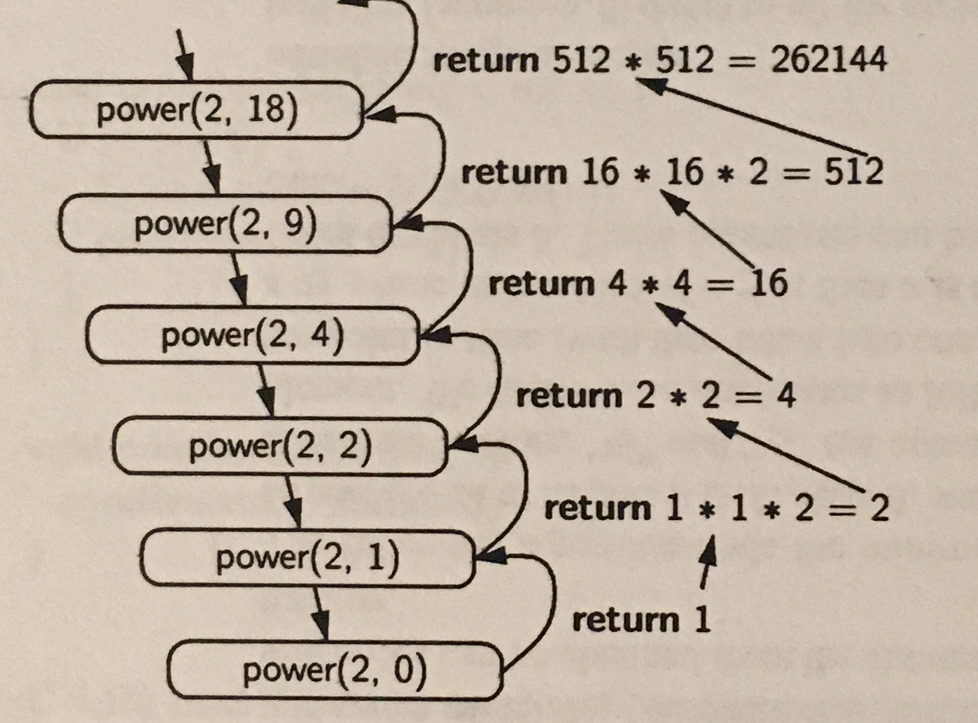
R-5.4 Draw the recursion trace for the computation of power(2,18), using the repeated squaring algorithm, as implemented in Code Fragment 5.9.

Slide 12
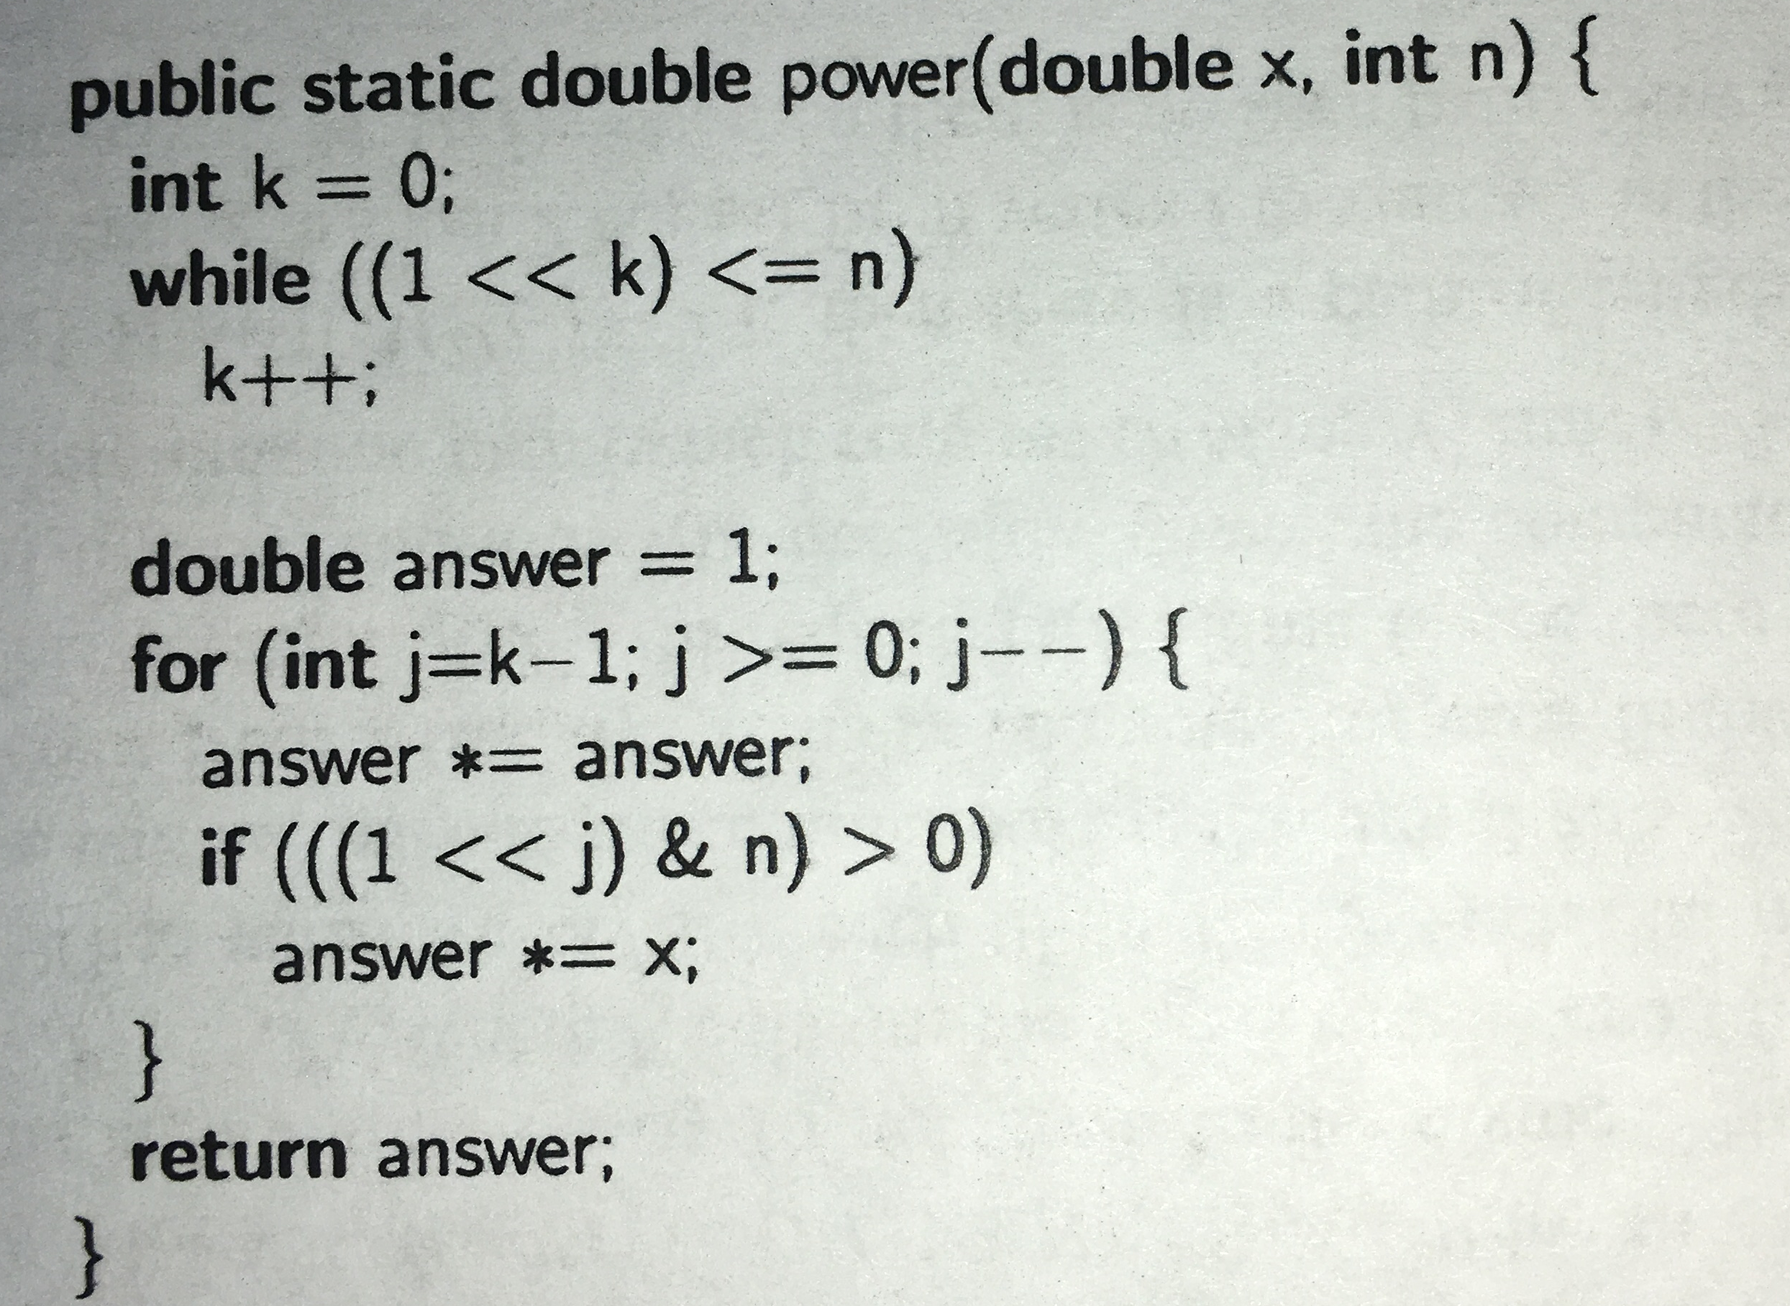
R-5.9 Develop a nonrecursive implementation of the version of the power method from Code Fragment 5.9 that uses repeated squaring.
<<:
Left shift
multiplying the number with
some power of two.
1<<2 -> 4
1<<5 -> 32

Slide 13
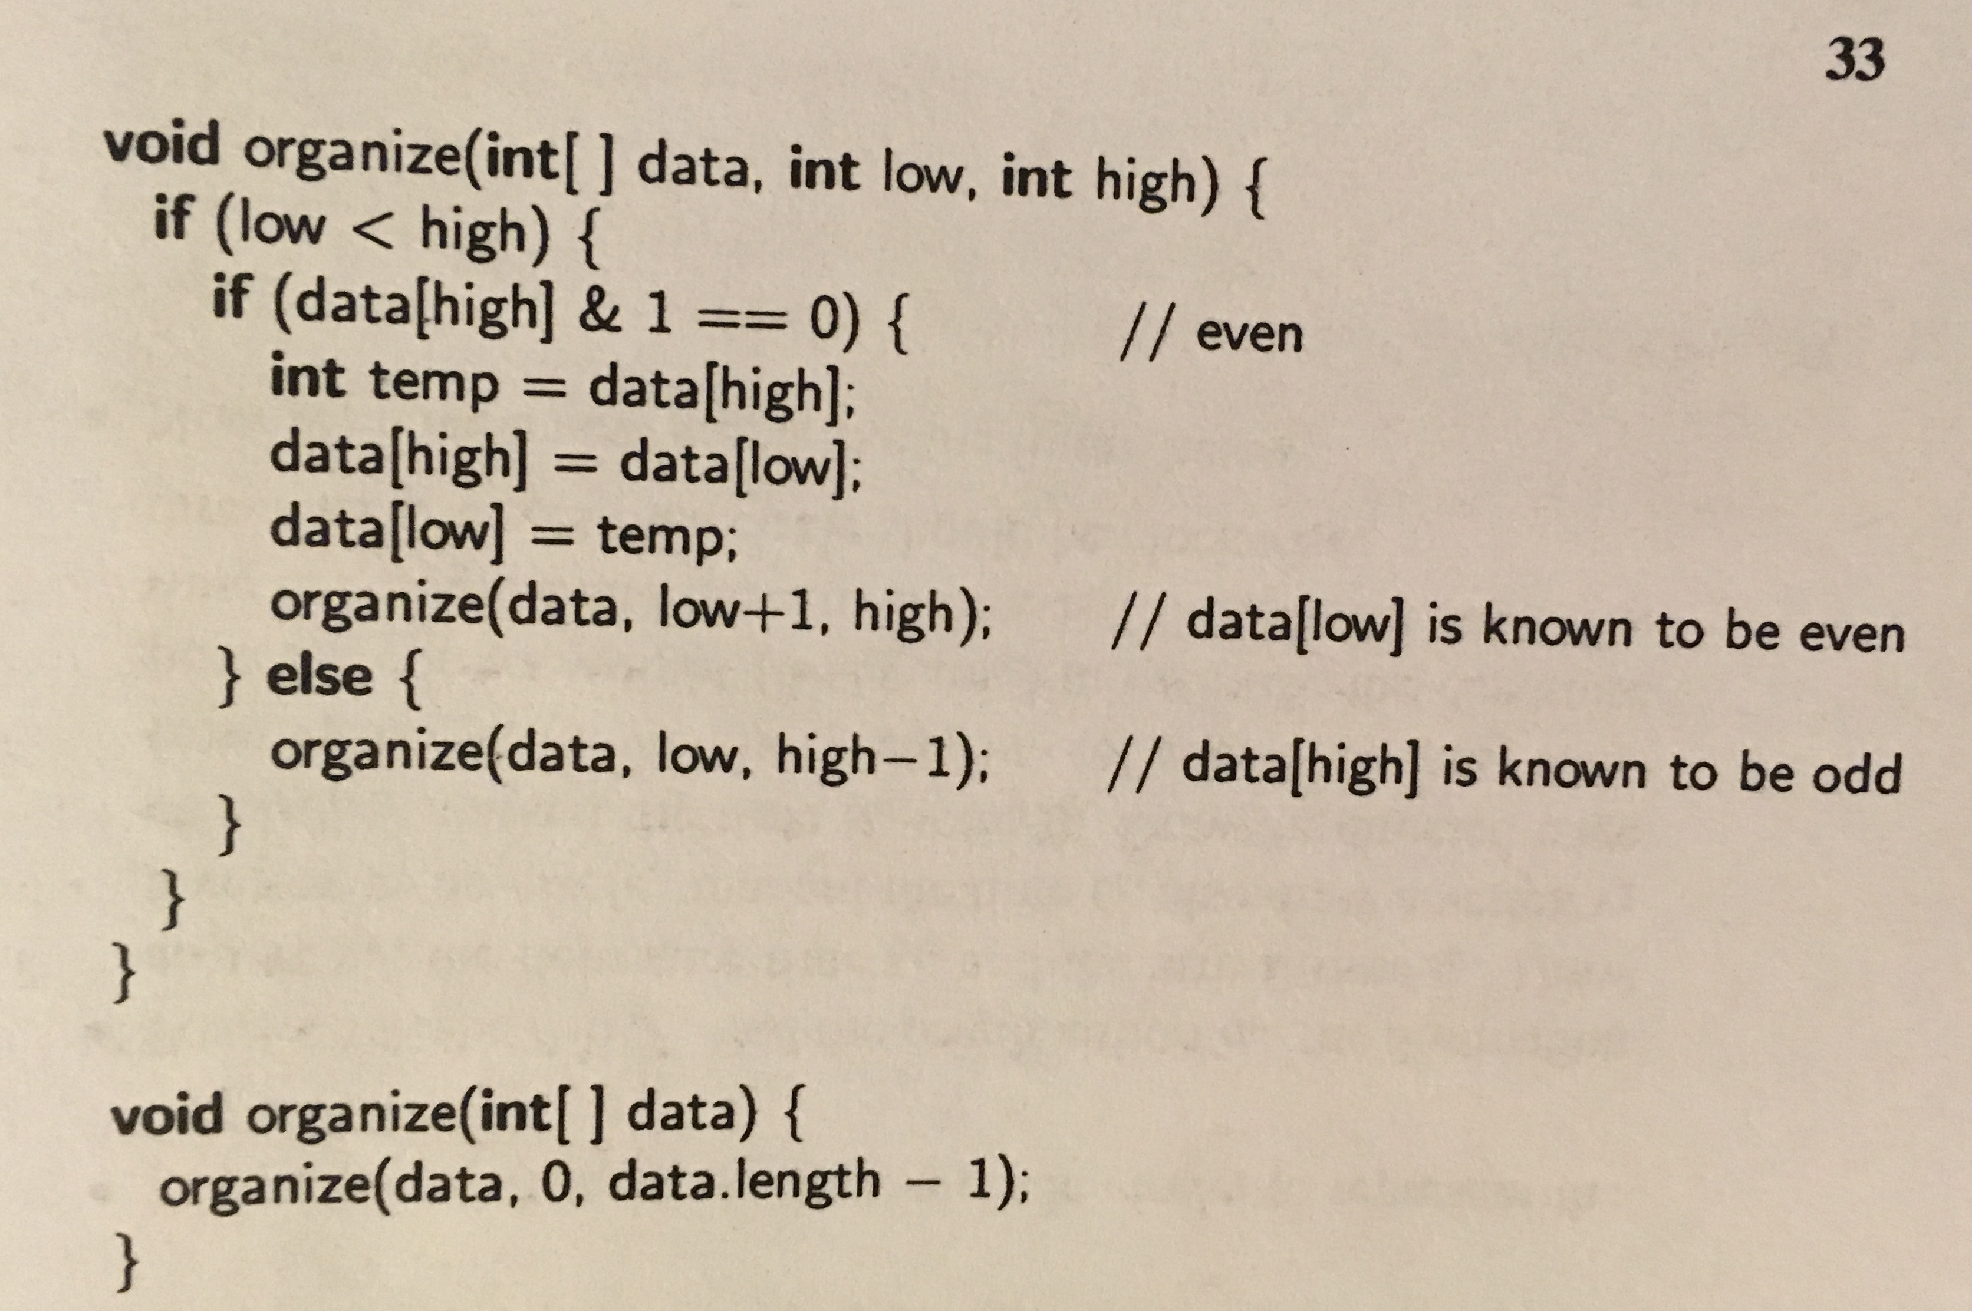

Slide 14
3, 8, 2,1,6, 7,4, 9

Slide 15
public void Remove(Stack S)
{
if (S.isEmpty())
return;
S.pop();
Remove(S); }

Slide 16
5, 3, 2, 8, 9, 1, 7, 6

Slide 17
No, It is not possible for the postorder and preorder traversal of a tree with more than one node to visit the same order.
Yes, for example: pre-order: ab post-order: ba
a
b

